Slide 1


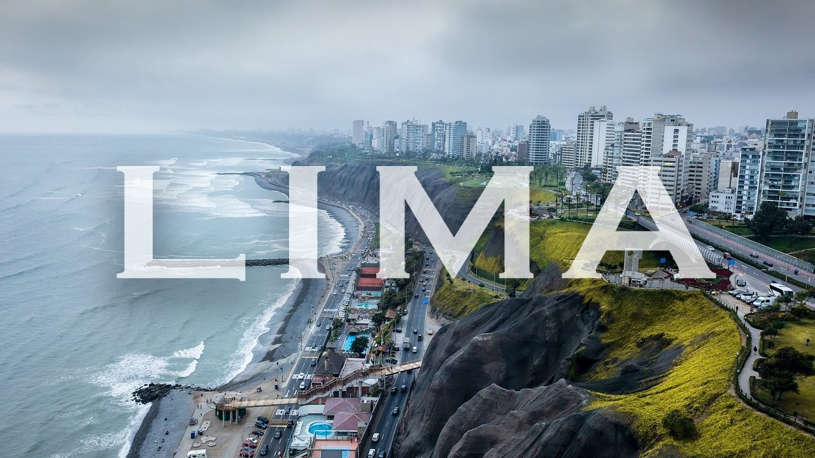
Selling the Outdoors in Lima
How Data Science can be leveraged to best supply the outdoors lifestyle of Lima with equipment produced for those looking to thrive.

Slide 2
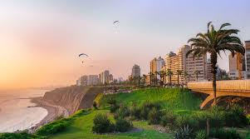
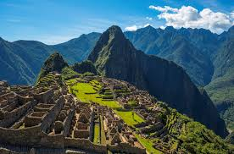
Peru is a Hotspot for Outdoors Enthusiasts
In 2019, over 4.3 million tourists arrived in Peru to visit sites all over the country, including Machu Pichu and the Cordillera Blanca*
Lima is the capital of Peru and is in the center of the country, on the coast. It is home to an international airport.
** https://www.statista.com/outlook/259/100/sports-outdoor/worldwide

Slide 3
The Sports and Outdoors Market Continues to Grow
The sports and outdoors market brings in more than $140 million in revenue annually*
In 2018, international tourism expenditures amounted to more than $4.3 trillion**
* https://www.statista.com/outlook/259/100/sports-outdoor/worldwide
** https://tradingeconomics.com/peru/international-tourism-expenditures-us-dollar-wb-data.html

Slide 4
Data
There are 43 districts in Lima*
Parks are the most common venue found in a district
There are no Sports or Outdoors shops amongst the top 10 venues per district
* https://en.wikipedia.org/wiki/List_of_districts_of_Lima

Slide 5
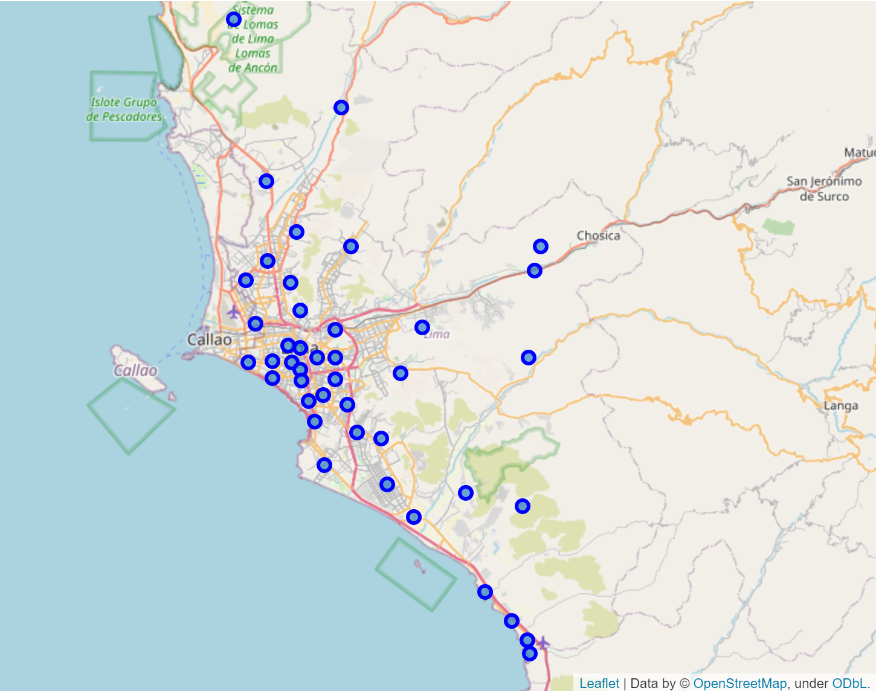
Map of 43 districts in Lima

Slide 6
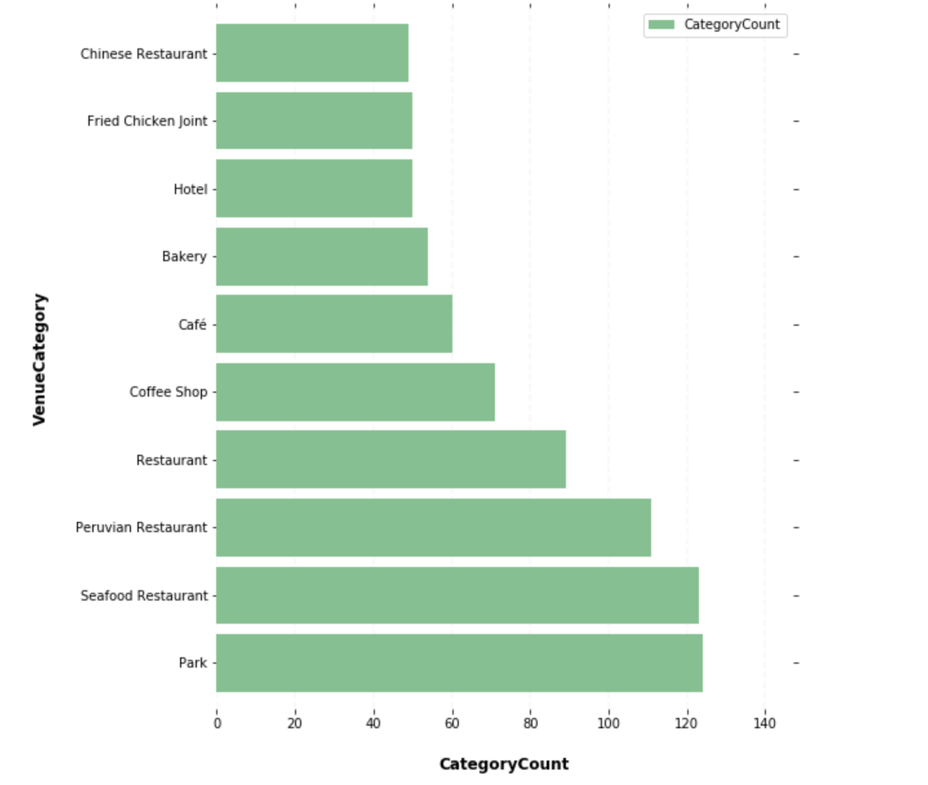
Top 10 Venue Categories

Slide 7
Data
There are 9 districts in Lima with a nearby “Athletics & Sports” venue
These districts show us that there is a market for people engaging with an active lifestyle
San Borja and Magdalena del Mar each have three such venues. They would be good markets to set up shop
* https://en.wikipedia.org/wiki/List_of_districts_of_Lima

Slide 8
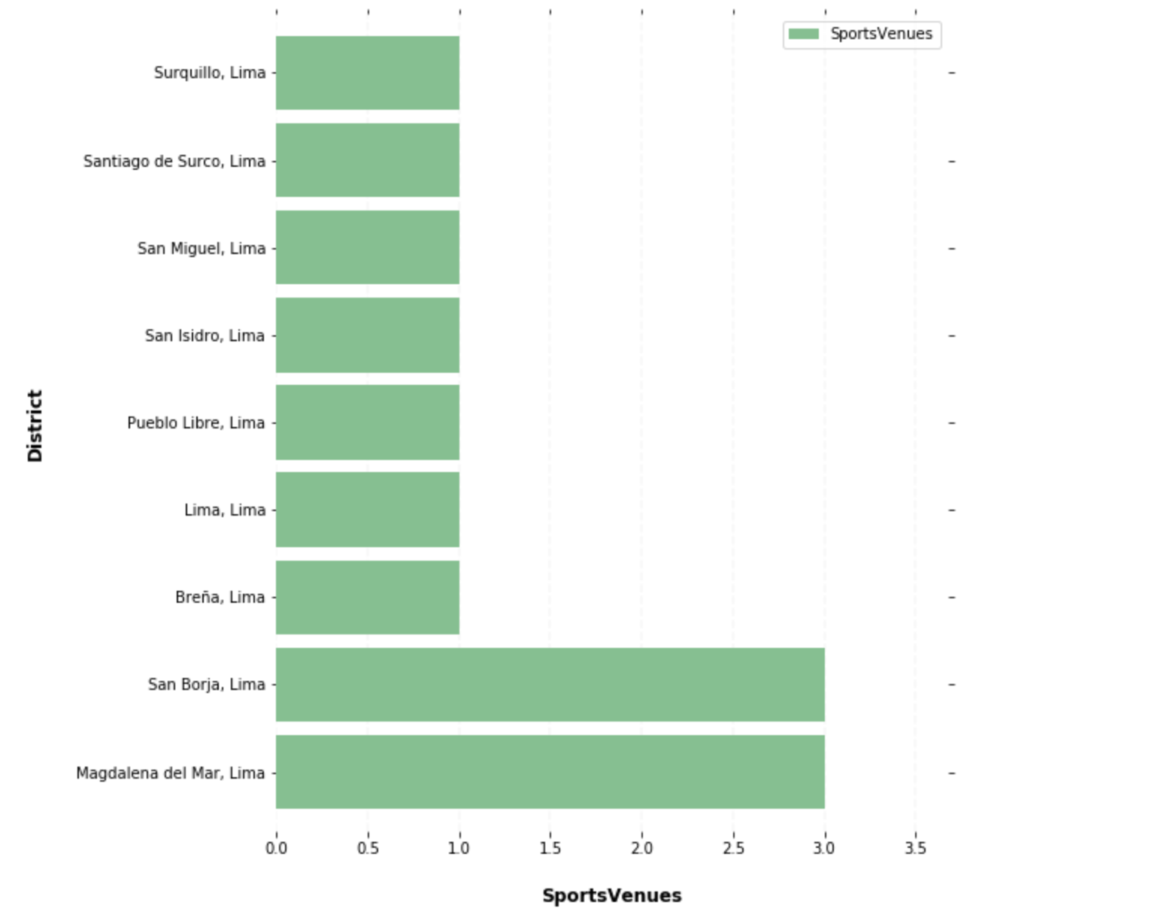
Districts with the most Sports Venues

Slide 9
Cluster Analysis
Cluster analysis can tell us how similar districts are to one another
We group the districts into five clusters and display the top 10 most common venues per each
* https://en.wikipedia.org/wiki/List_of_districts_of_Lima

Slide 10
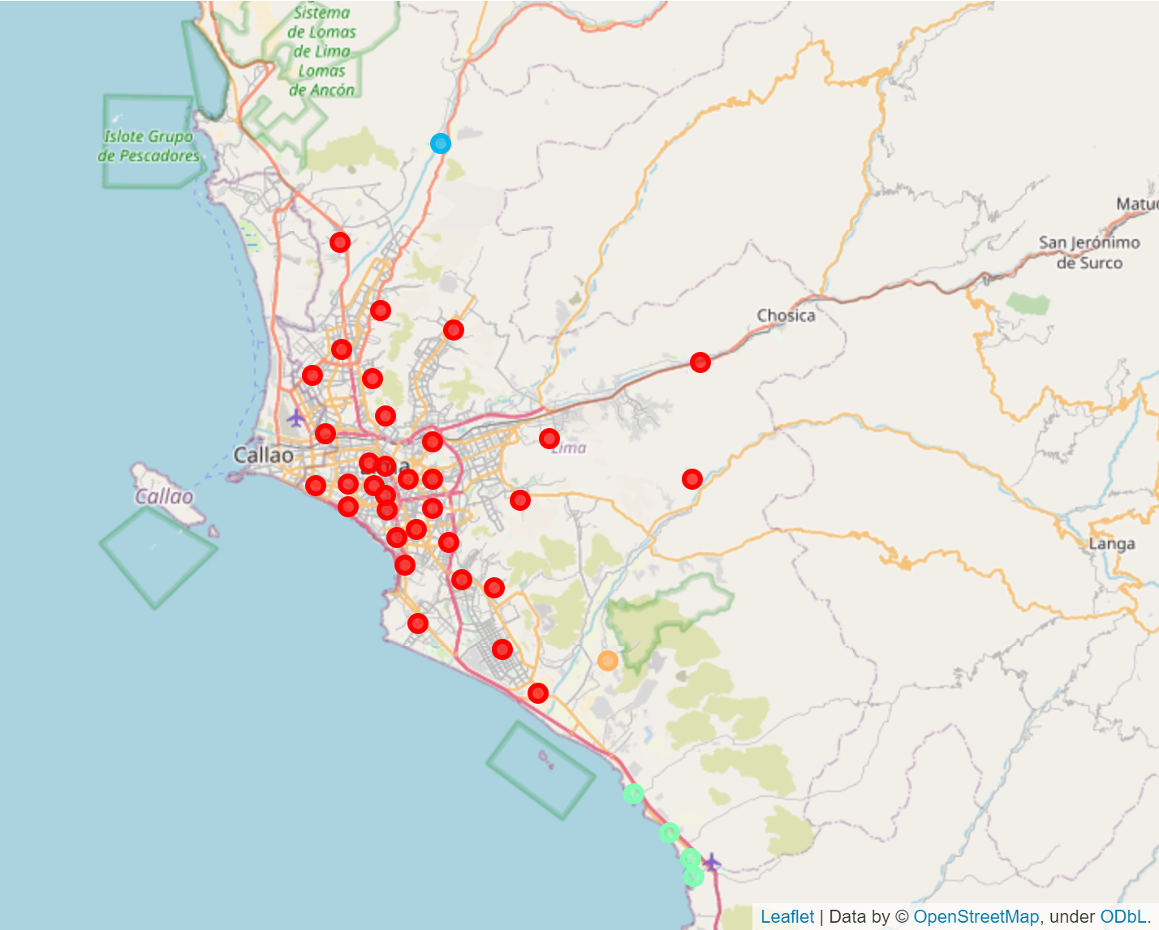
Map of Lima Clusters

Slide 11
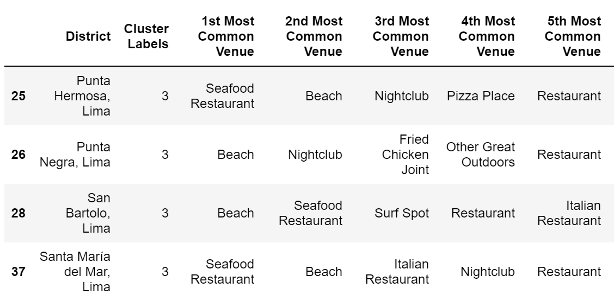
Analysis of Lima Clusters

Slide 12
Competition
Two districts currently have a sporting goods shop
Both are in cluster 0, which tells me districts in that cluster would be good market

Slide 13
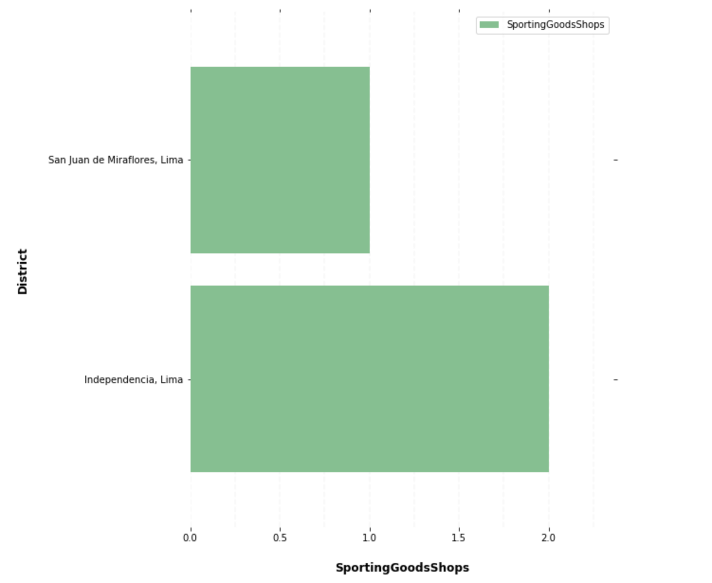
Competition

Slide 14
Conclusion
The San Borja and Magdalena del Mar districts have the most “Athletics & Sports” venues without also having a “Sporting Goods Shop”
Our cluster analysis puts them both in the same group as districts which already have a sporting goods presence
San Borja and Magdalena del Mar are both good locations to set up a store that caters to and Outdoors market

